Slide 1
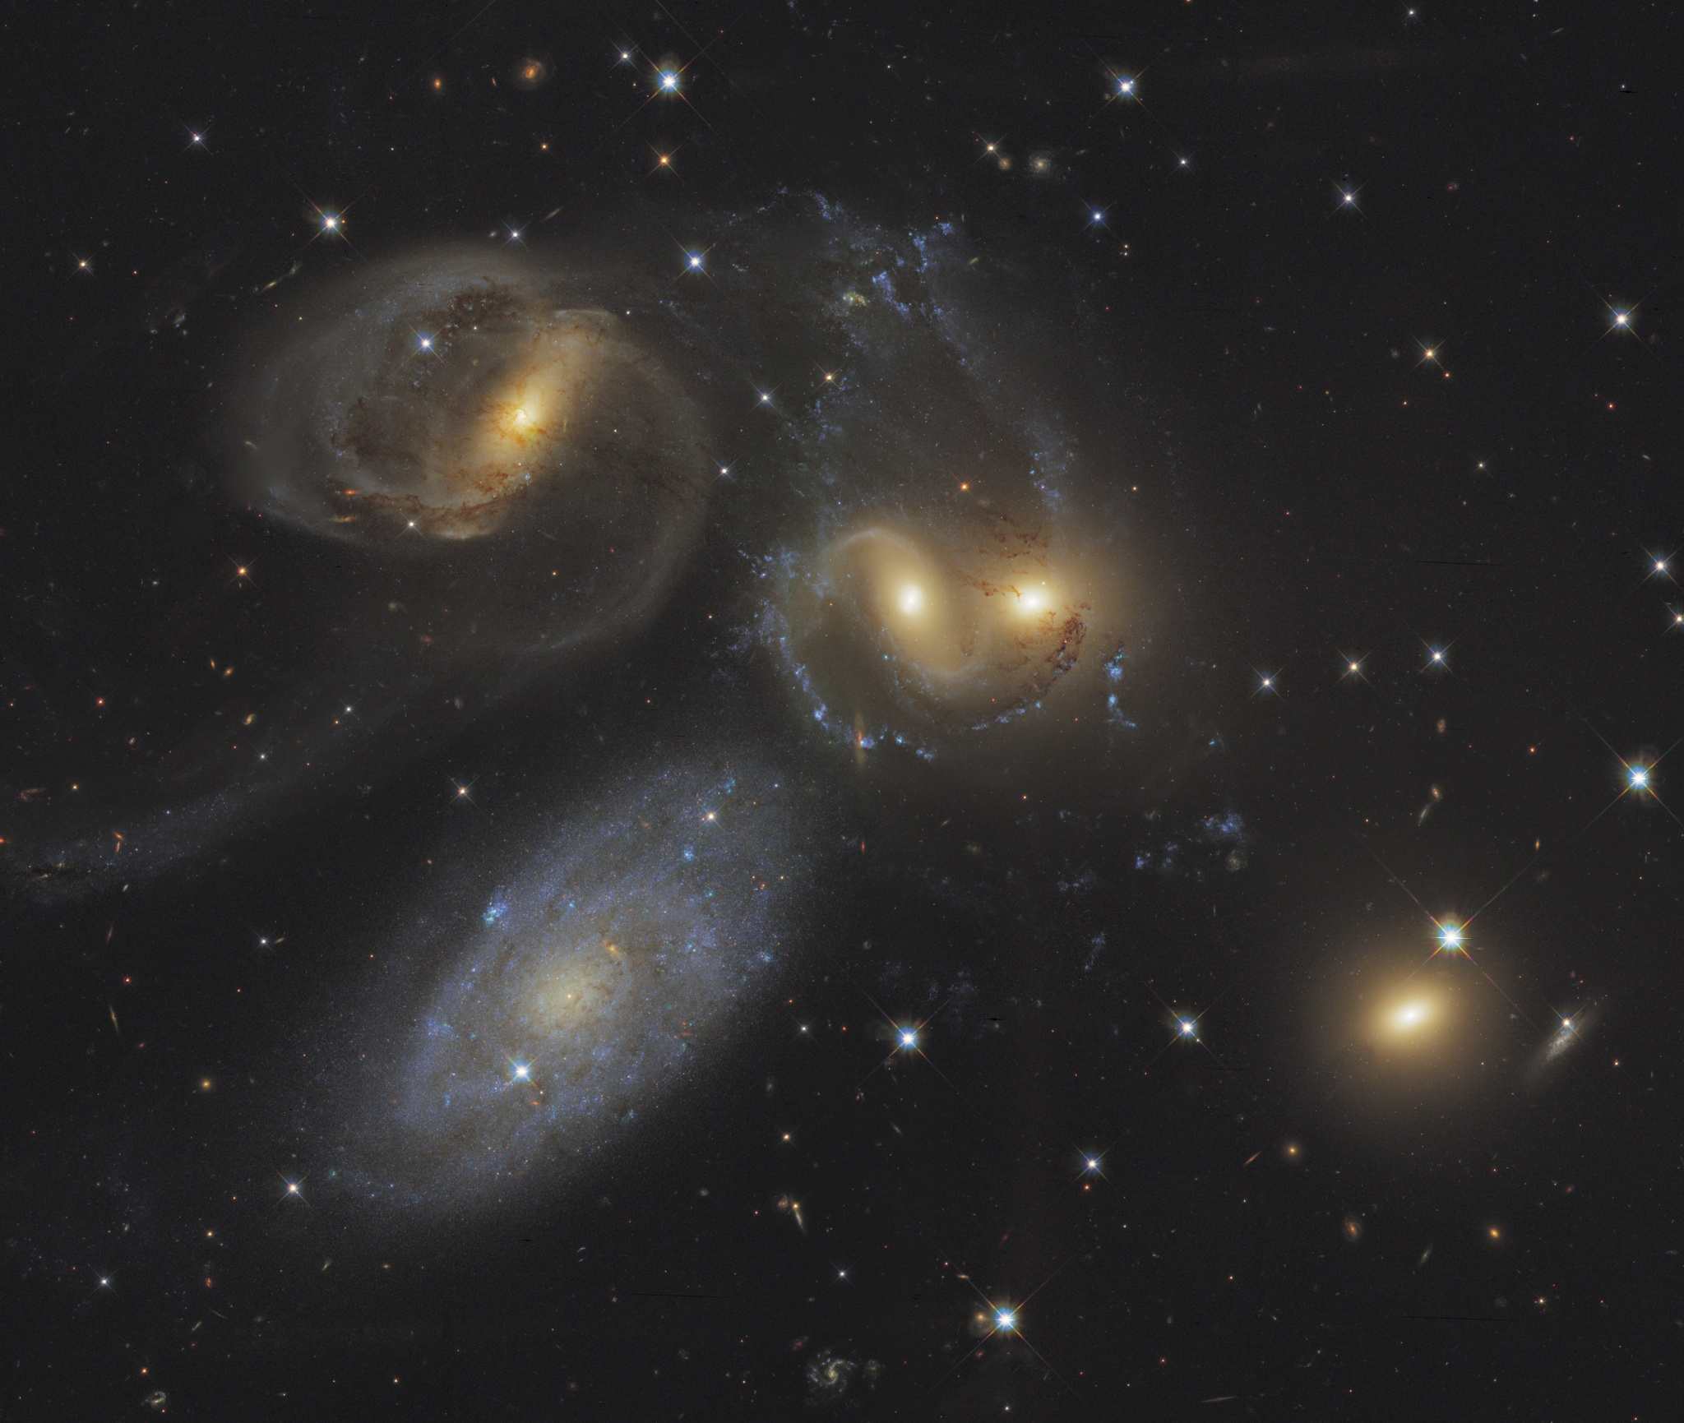




^{星系总动员}
Science and Outreach Hand-in-Hand
Dr. Karen Masters
Leverhulme Early Career Fellow
University of Portsmouth, UK
@KarenLMasters

Slide 2
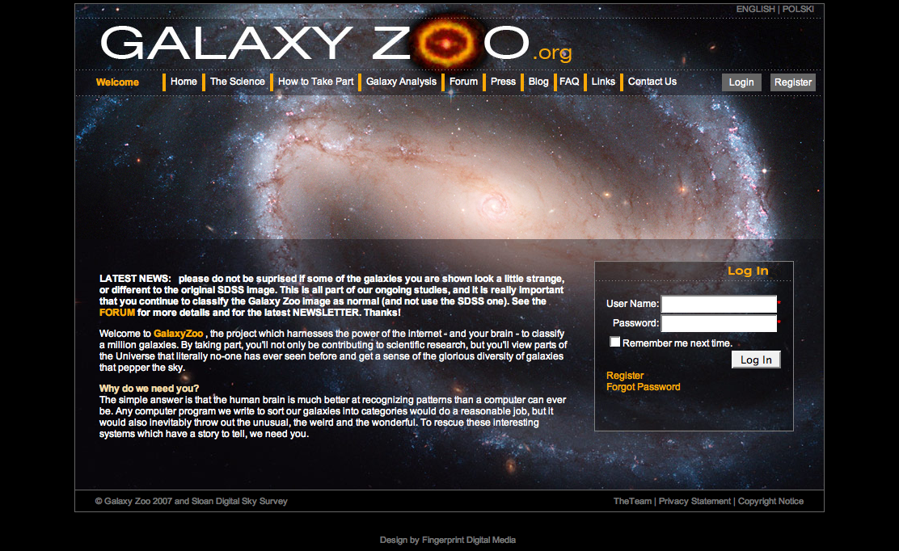
Launched July 2007
Galaxy Zoo - the project which harnesses the power of the internet - and your brain - to classify a million galaxies.

Slide 3
Why Look – galaxies aren’t all the same…
Mass division
Redder
Red sequence – early types
Green valley (very sparse)
COLOUR
Blue cloud
– spiral galaxies
Bluer
Smaller/dimmer
Mass (Luminosity)
Bigger/brighter

Slide 4
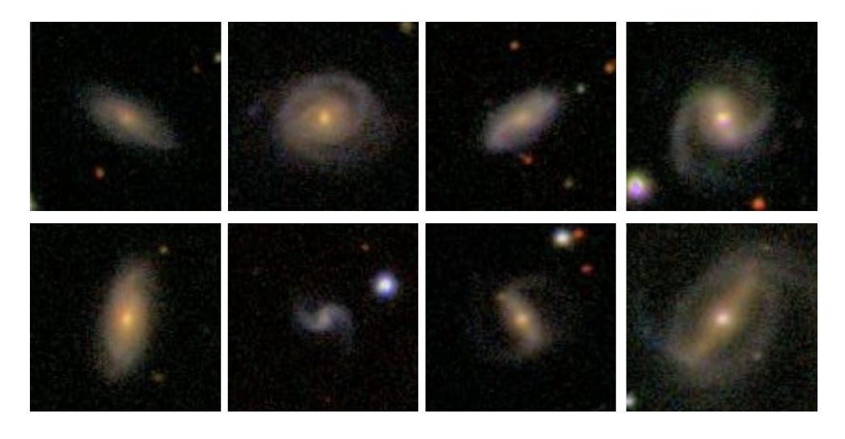
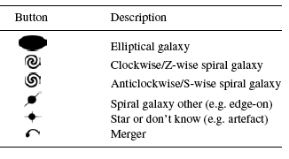
Spiral Arm Direction
Had been claims of an excess of spiral arms in one direction over the other…..
Z wise
S wise

Slide 5
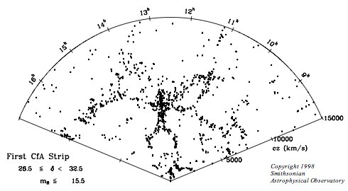
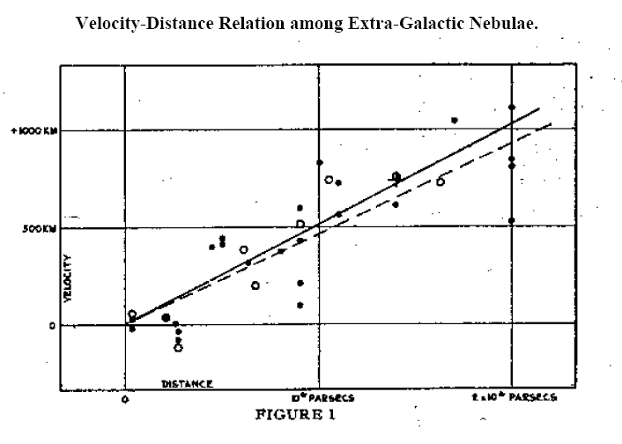
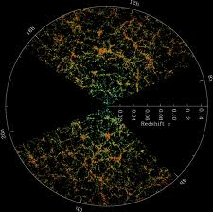
How Many Galaxies Are There?
57 years
x 50
1986: CfA redshift survey - discovery of large scale structure (1100 galaxies; Huchra & Geller)
1929: Edwin Hubble discovers expansion of the Universe (24 galaxies)
22 years
x 1000
2008: Final release of SDSS Main Galaxy Sample (1 million galaxies)

Slide 6
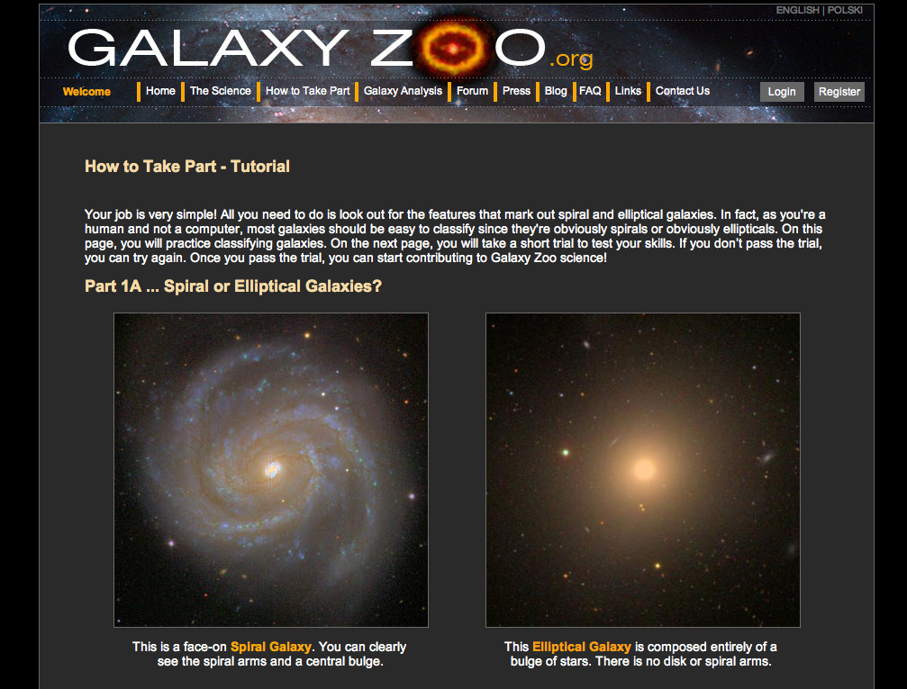
How to look at a million galaxies – ask for help!

Slide 7
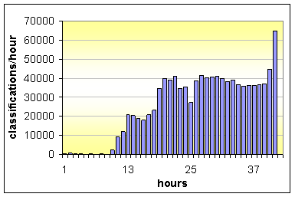
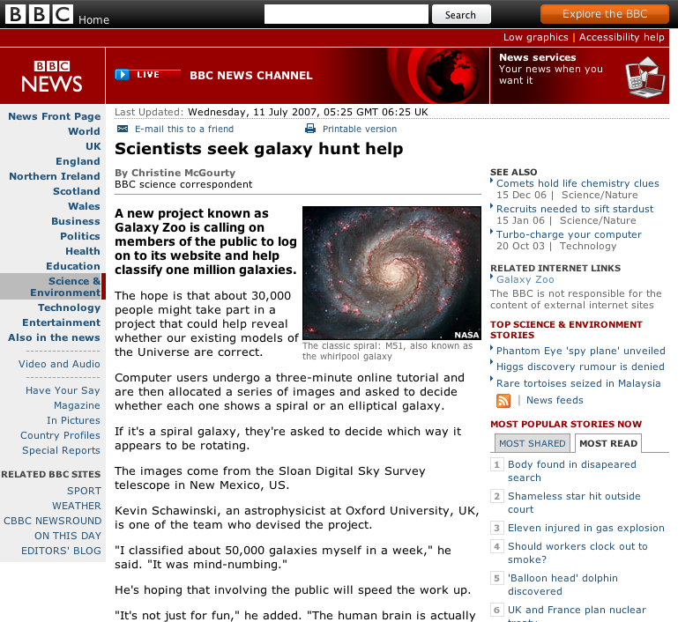
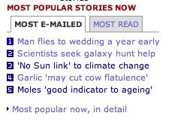
Huge Success

Slide 8
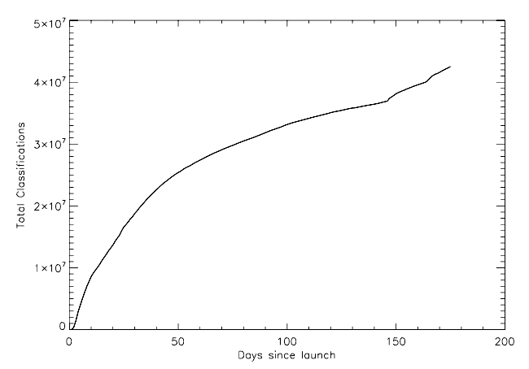
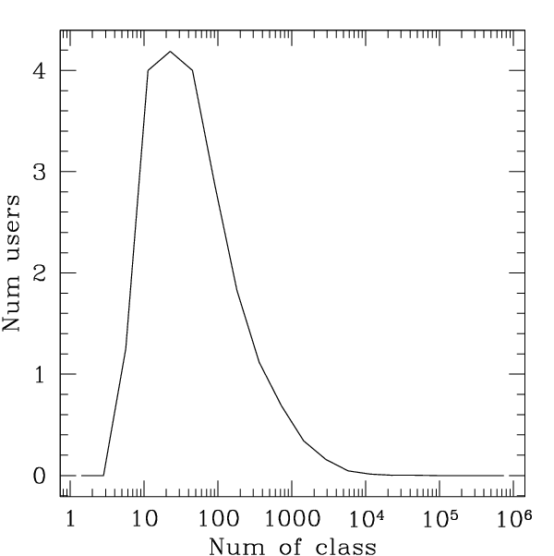
Most people look at about 20 galaxies.
All galaxies looked at by at least 20 people (median 38).
Number Users
0 10 100 1000 100000

Slide 9
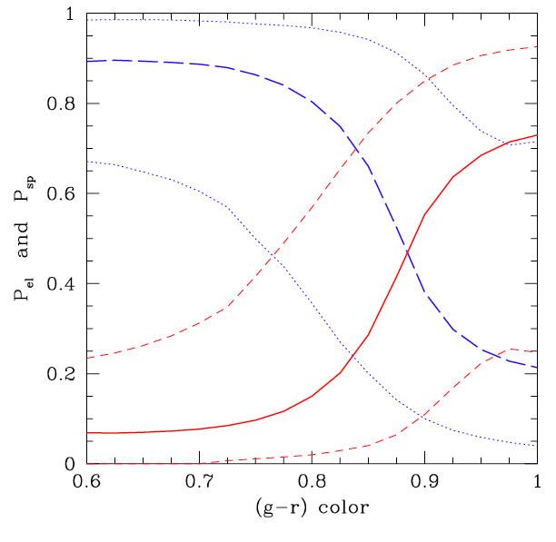
First Science Results
Colour and morphology are correlated, but not equivalent
Bamford et al. 2009, Skibba et al. 2009, Schawinski et al. 2009,
Masters et al. 2010a,b
Median prob. of being spiral
Classification “probability” from Galaxy Zoo
Colour = star formation history
Morphology = dynamical history
Median prob. of being early type
 | Dynamical History
SF History |  | Bulge (Early) | Disk (Spiral)
 | Red
 | Blue
Blue
Red
Skibba et al. 2009

Slide 10

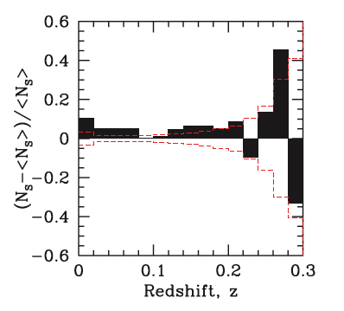
No Preferred Rotation Direction
Z wise
S wise
Land et al 2008:
there is an “S-wise” excess
the excess remains for mirrored images
  site design
  neurological effect (eg. Leviant’s Enigma)
Consistent with isotropic universe

Slide 11
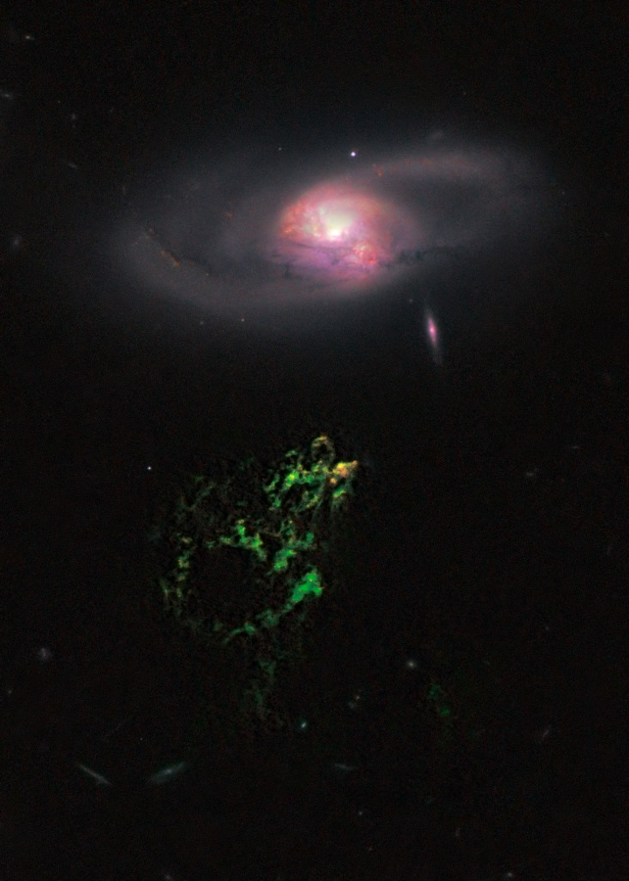
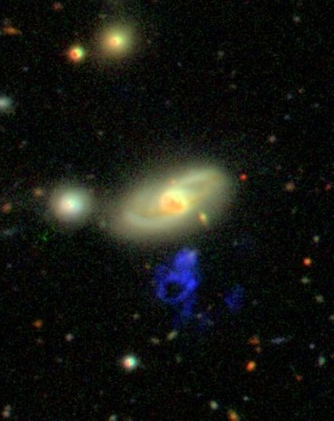
You never know what you’ll find…
A quasar which has recently turned off….
“Hanny’s Voorwerp”
Lintott et al. 2009, Schawinski et al. 2010,
Keel et al. 2012a,b
Jozsa et al. 2009, Rampadarath et al. 2010, Garrett et al. 2011

Slide 12
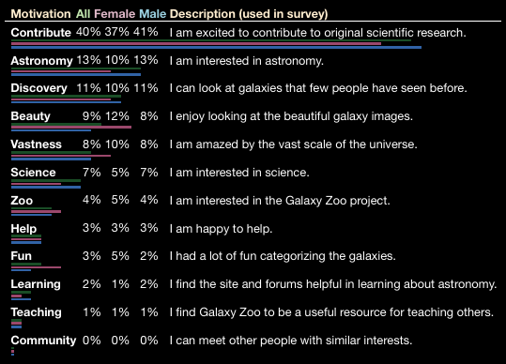
Why Do People Do This?
Galaxy Zoo: Exploring the Motivations of Citizen Scientists. (Raddick et al. 2009 astroph/0909.2925)
Galaxy Zoo doesn’t work unless the volunteers see scientific results coming out.

Slide 13
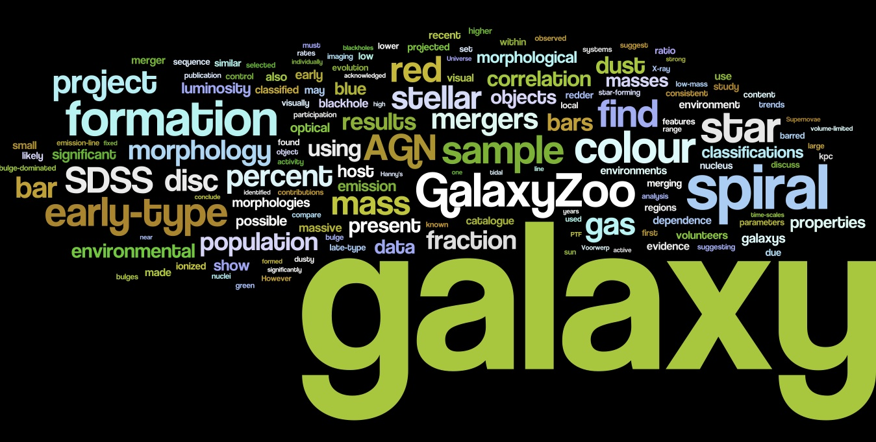
~35 papers; h-index=15
Notes:
Words in abstracts of galaxy Zoo science papers

Slide 14
Papers on Barred Spirals:
Red spirals have a lot more bars than similar blue spirals
(Masters et al. 2010b MNRAS 405, 78)
Statistically there are more bars in redder (more massive) disc galaxies
(Masters et al. 2011 MNRAS 411, 2026)
Redder spirals not only have more bars, but also longer (stronger) and redder bars
(Hoyle, Masters et al. 2011 MNRAS 415, 3627)
Barred red spirals are more clustered only on scales of ~400 kpc than red spirals in general
(Skibba, Masters et al. 2012 MNRAS 423, 1485)
Spirals with more atomic gas content are less likely to have bars – bars help to quench star formation?
(Masters et al. 2012 MNRAS 424, 2180)
There is a decrease in bar fraction in very close pairs
(Casteels, Bamford, Skibba, Masters et al. 2012 MNRAS submitted)
Discover an “epoch of bar formation” at z~0.7 in massive disc galaxies in Galaxy Zoo HST.
(Melvin, Masters et al. in prep.)

Slide 15
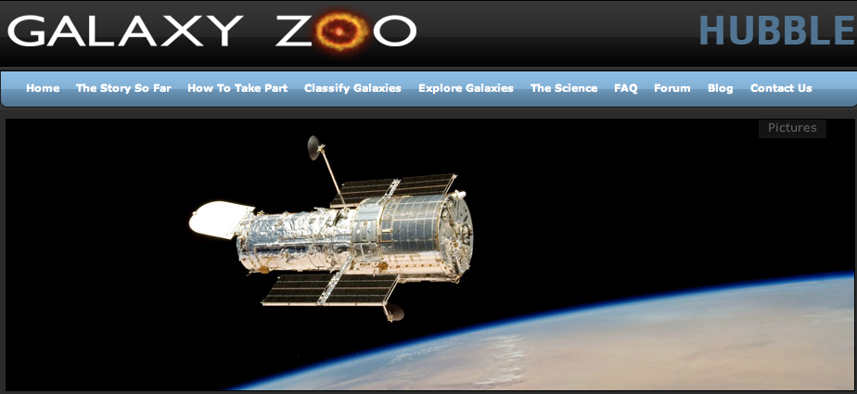
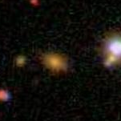
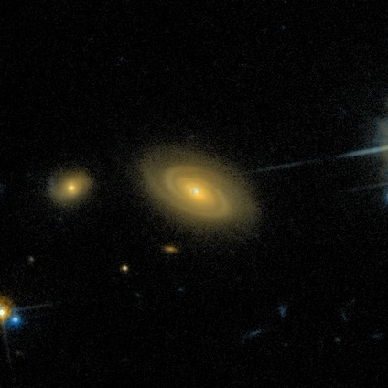
Notes:
Hubble live now

Slide 16
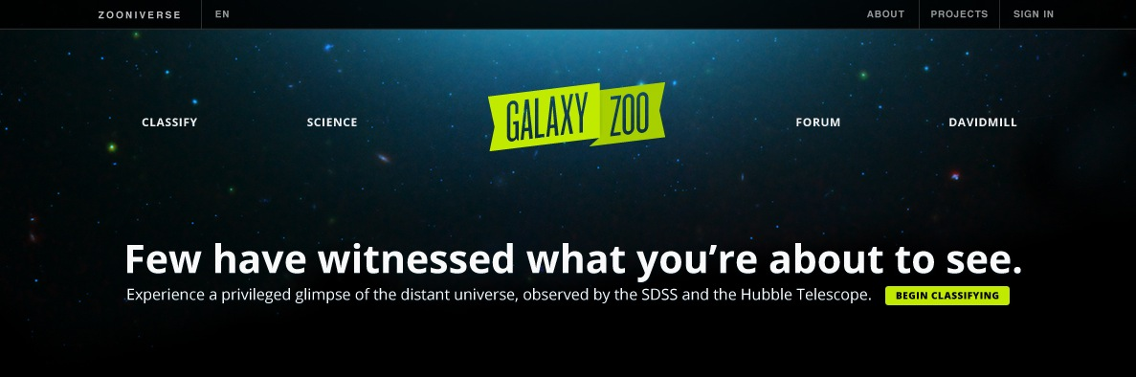
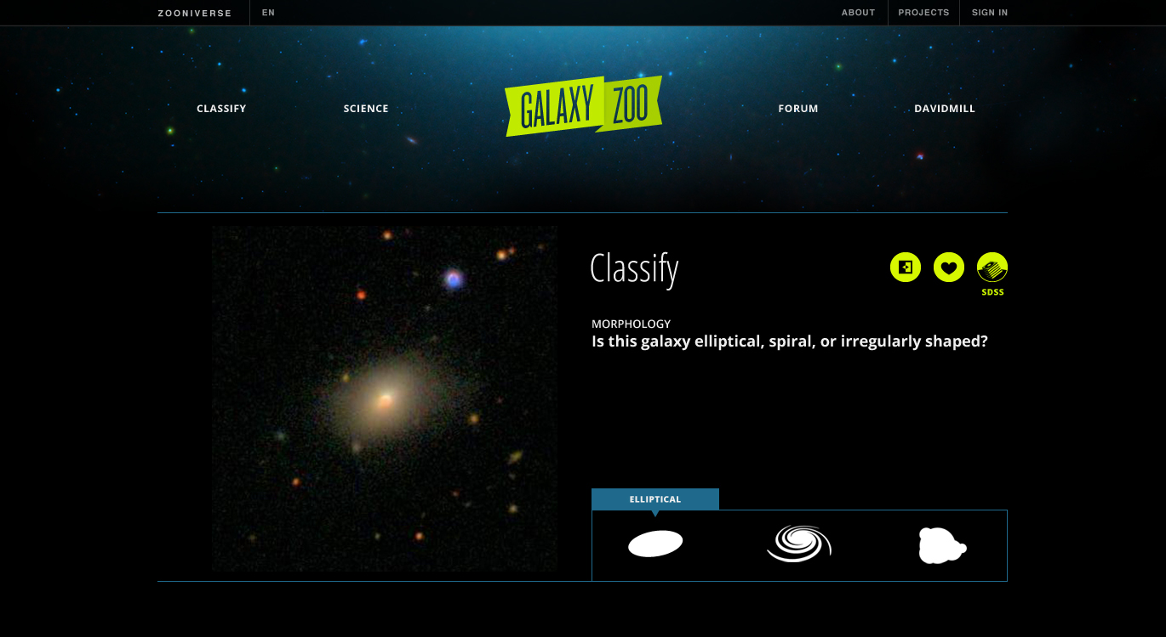
Notes:
Fifth birthday on July 11th 2012. Relaunch soon with new SDSS and Hubble Images (both together).

Slide 17
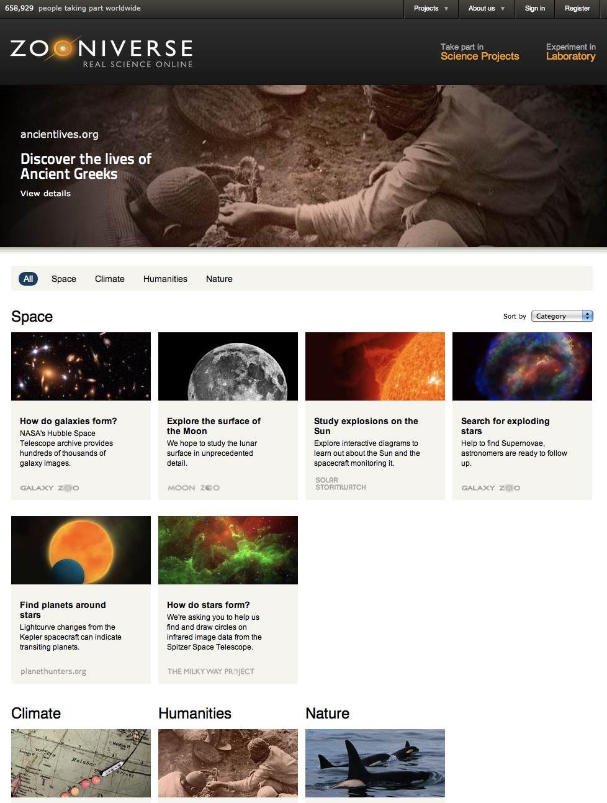

.org

Slide 18
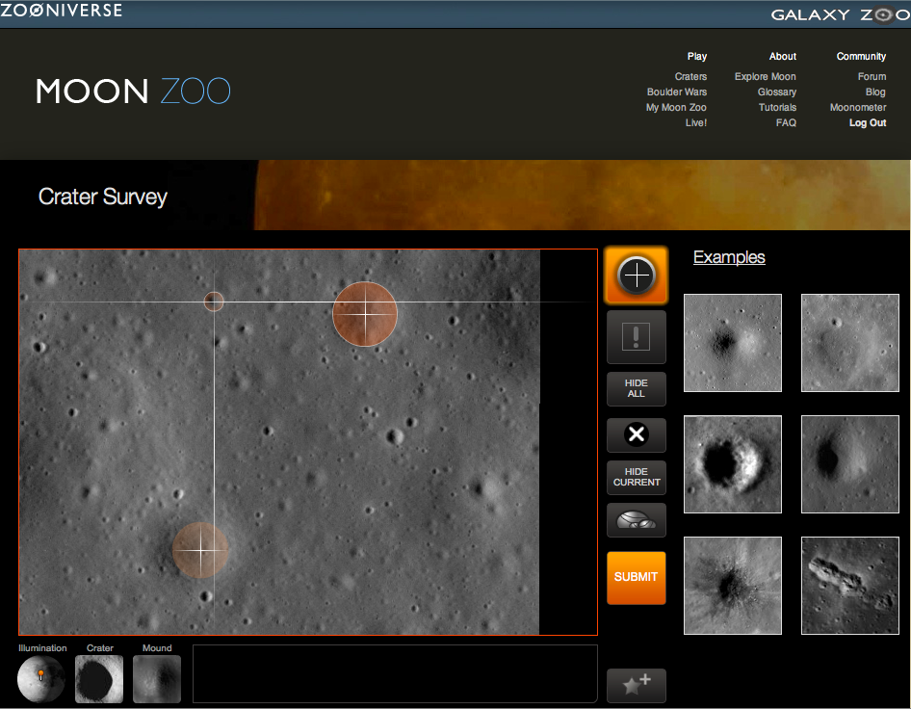

Slide 19
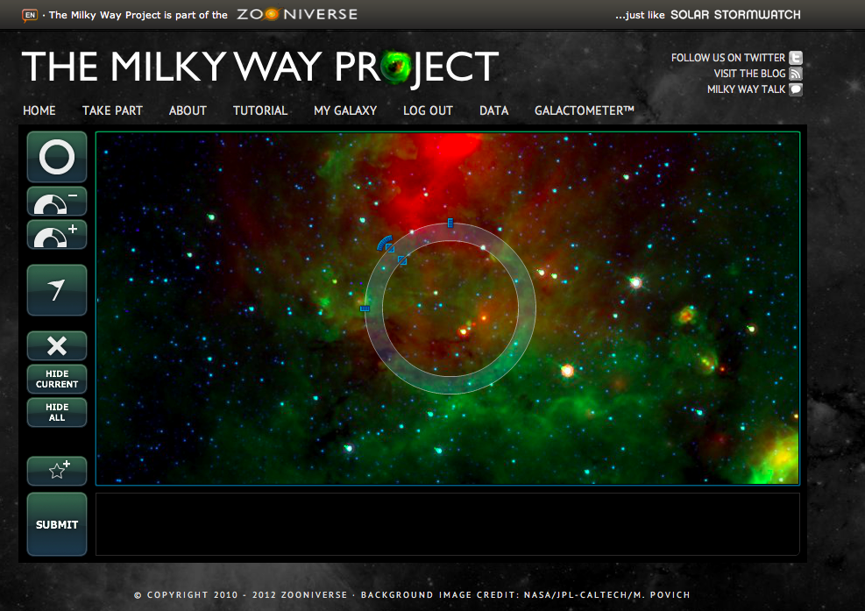

Slide 20
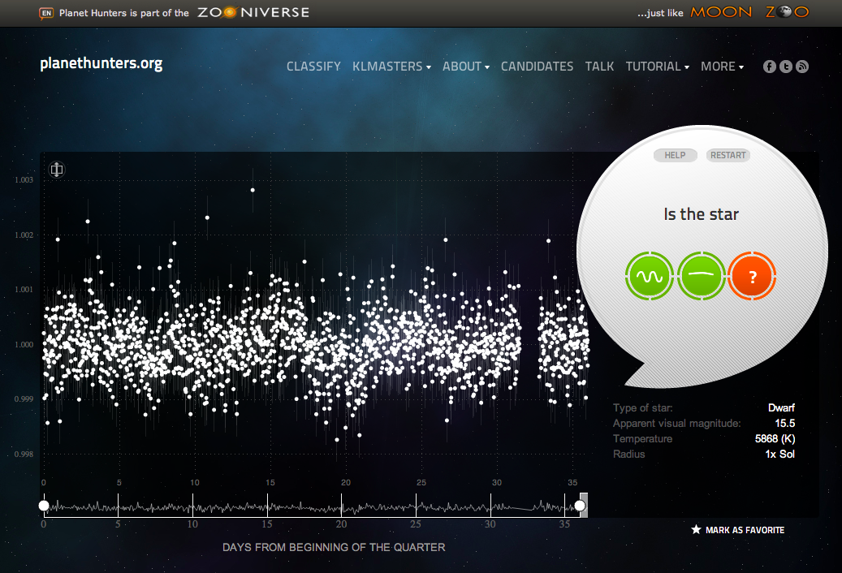

Slide 21
Are there enough citizen scientists for all this?

Slide 22
16 years
every day

Slide 23
Every Zooniverse Project Must
Have a solid science case
Require citizen scientists
Commit resources to analysing the data
Communicate with the public

Slide 24
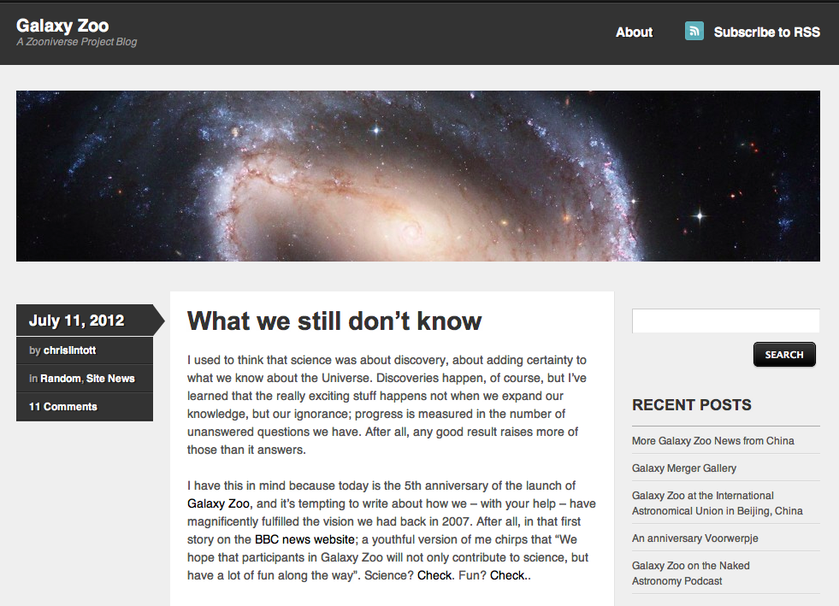
http://blog.galaxyzoo.org/

Slide 25
Why Do People Do This?
Galaxy Zoo: Exploring the Motivations of Citizen Scientists. (Raddick et al. 2009 astroph/0909.2925)

Slide 26
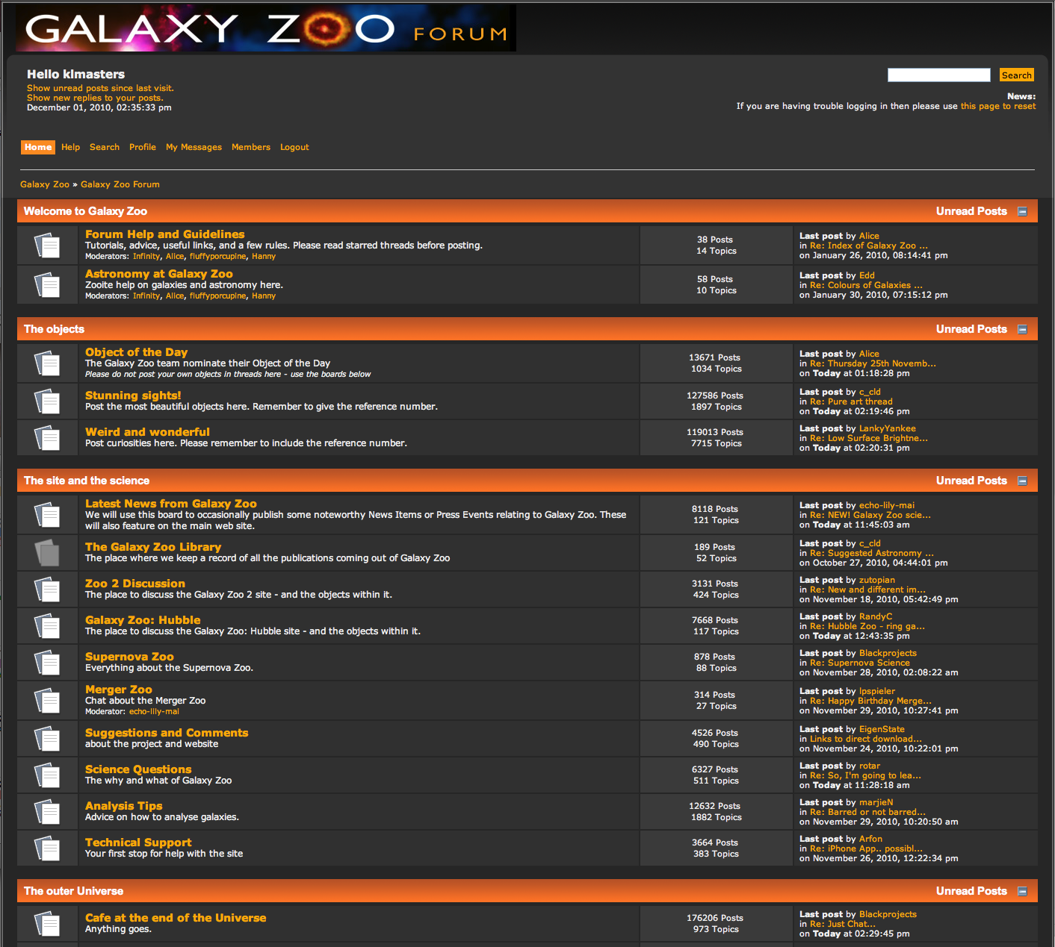

Slide 27
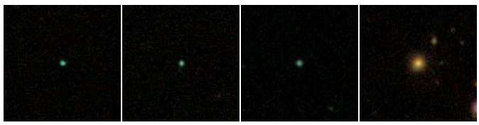
Forum Based Science
Overlapping galaxies
Rings
Lenses
Irregulars
“Green peas”
Hanny’s Voorwerp

Slide 28
On going developments
Encouraging deeper engagement
Making discovery easier

Slide 29
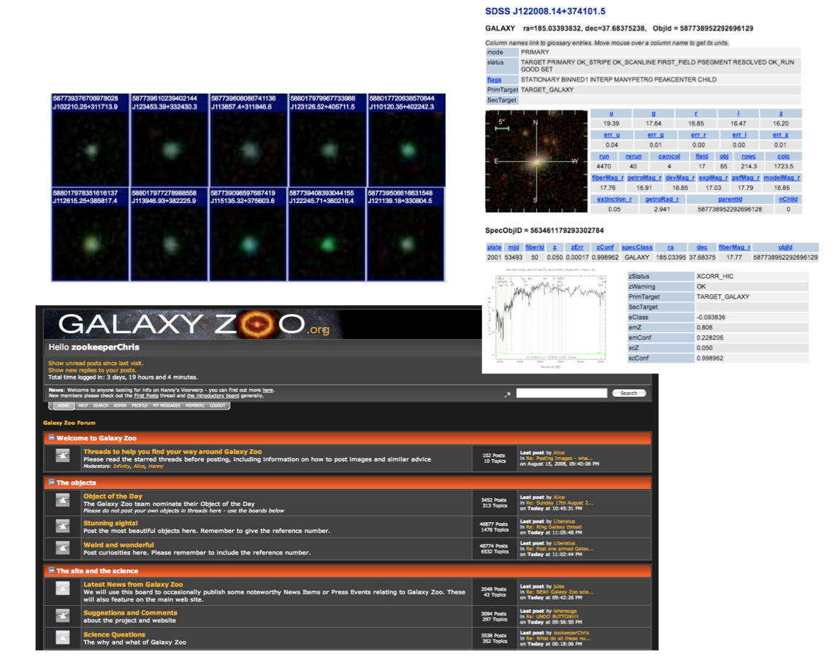

Slide 30
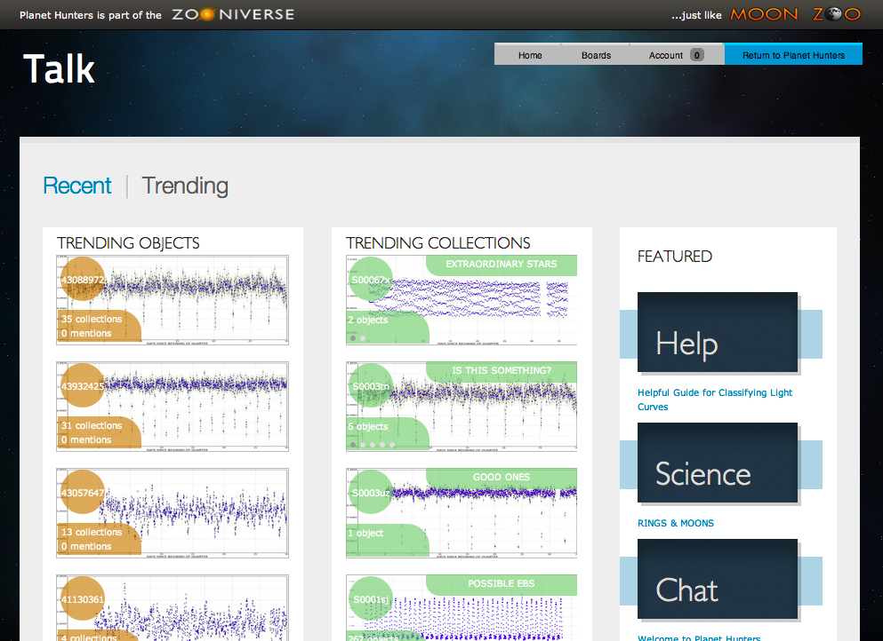

Slide 31
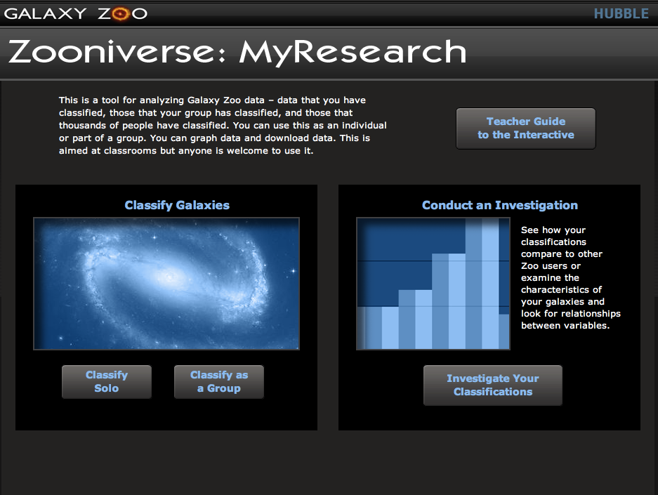

Slide 32
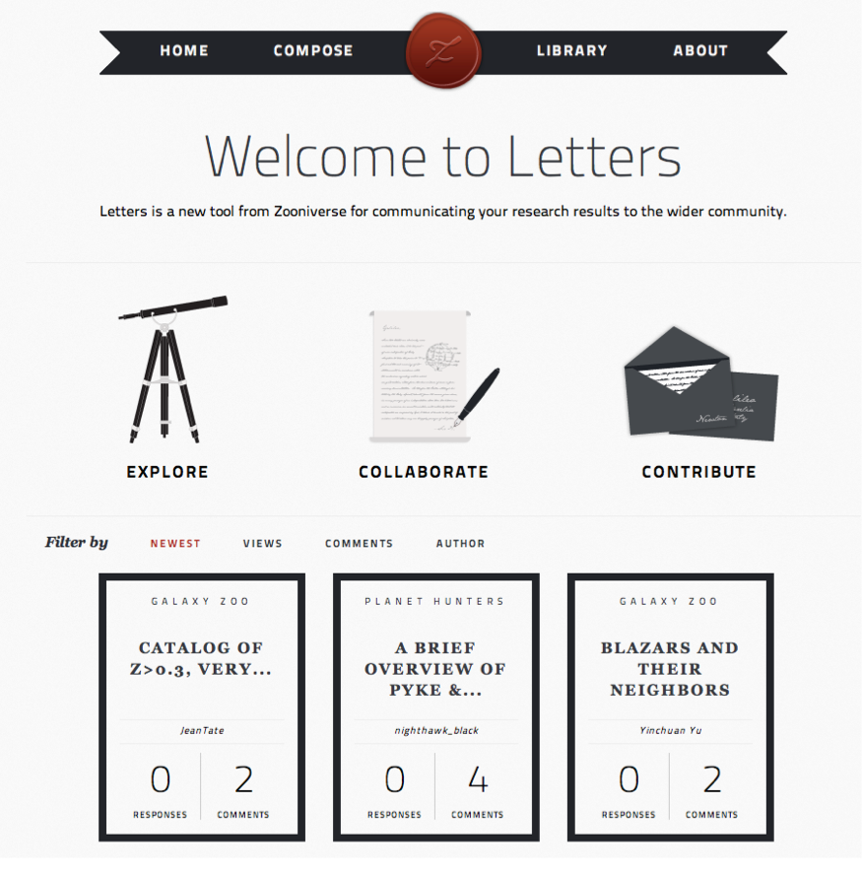

Slide 33
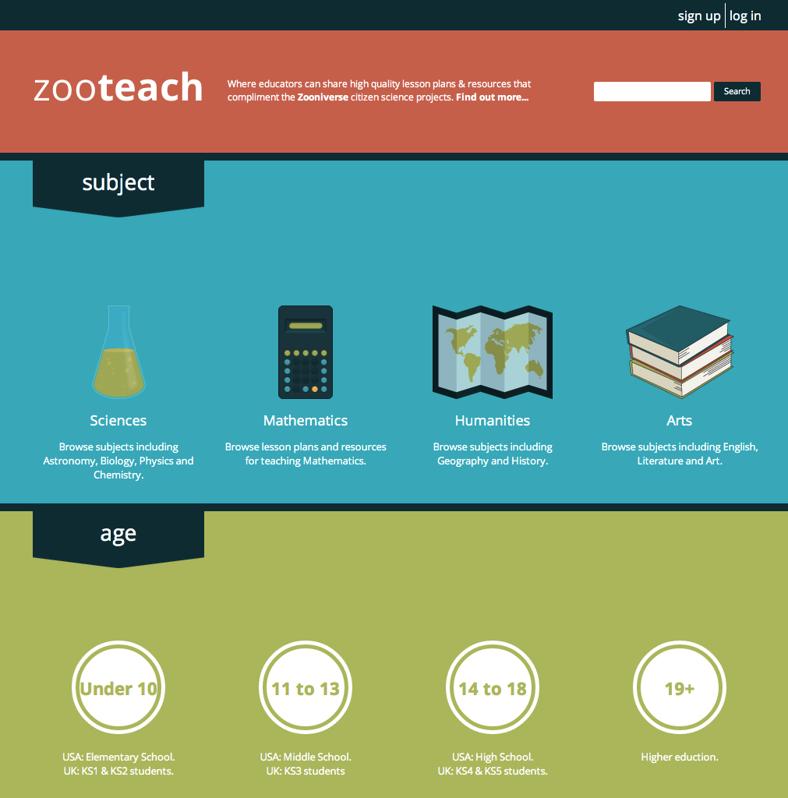

Slide 34
Added extras….

Slide 35
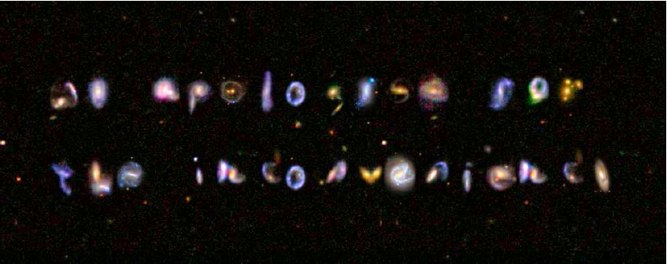
Alphabet Soup
Galaxy Zoo April Fools Day paper:
“Unusual New Class of Galaxy Clusters”, by Marvin Pedbost, Trillian Pomalgu and the Galaxy Zoo Team (especially Steven Bamford)
Try it: http://mygalaxies.co.uk/

Slide 36
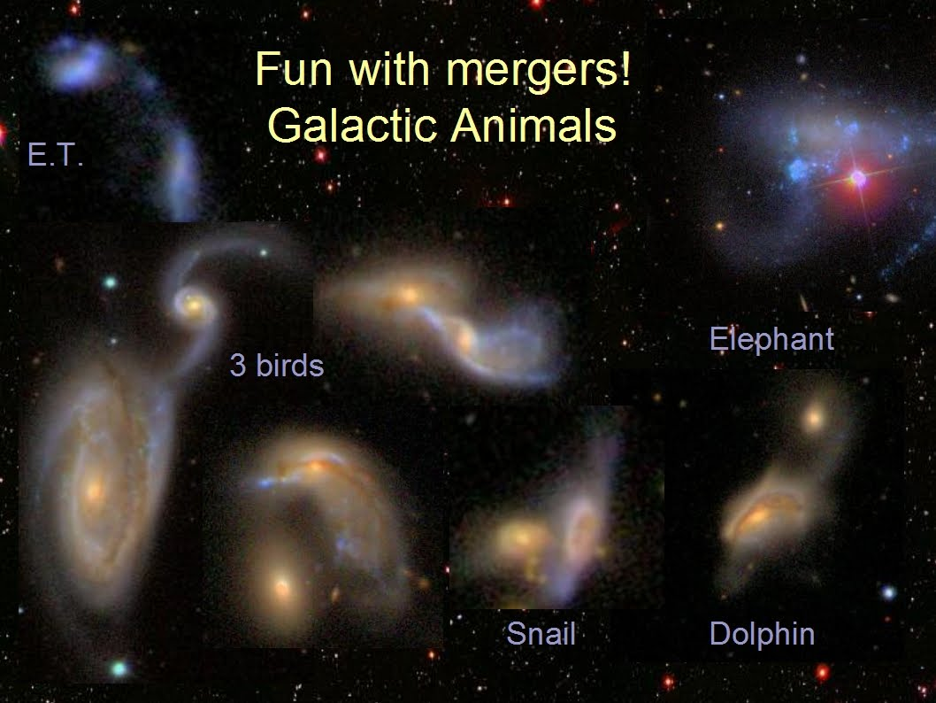
Alice’s Animals
Credit: Alice Sheppard

Slide 37
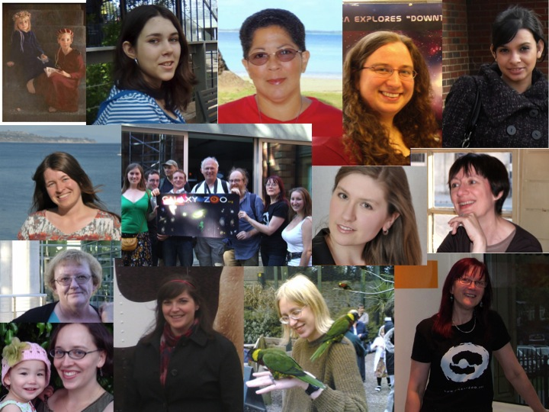
She’s an Astronomer
http://blogs.zooniverse.org/galaxyzoo/category/shes-an-astronomer-3/
Part of International Year of Astronomy (2009) Project
16 women involved in Galaxy Zoo
  8 “zooites”
  8 professionals
Age range from 15 to ~50; students to full professor
Interviews conducted in English, but also native language translations for 4 (Spanish, German and Dutch).
Notes:
Here’s the full list of interviews:Zooites:Hanny Van Arkel (Galaxy Zoo volunteer and finder of Hanny’s Voorwerp). Hanny’s interview in het Nederlands.Alice Sheppard (Galaxy Zoo volunteer and forum moderator).Gemma Couglin (”fluffyporcupine”, Galaxy Zoo volunteer and forum moderator).Aida Berges (Galaxy Zoo volunteer – major irregular galaxy, asteroid and high velocity star finder). Entrevista de Aida en español.Julia Wilkinson (”jules”, Galaxy Zoo volunteer. Frequent forum poster, and member of irregular and HVS projects).Els Baeton (”ElisabethB”, Galaxy Zoo folunteer. Frequent forum poster, and member of most of the spin-off projects!). Els’s interview in het Nederlands.Hannah Hutchins (Galaxy Zoo volunteer, forum poster and co-creator of Galaxy Zoo APOD)Elizabeth Siegel (Galaxy Zoo volunteer, forum poster)Researchers:Dr. Vardha Nicola Bennert (researcher at UCSB involved in Hanny’s Voorwerp followup and the “peas” project). Vardha’s Interview auf Deutsch.Carie Cardamone (graduate student at Yale who lead the Peas paper).Dr. Kate Land (original Galaxy Zoo team member and first-author of the first Galaxy Zoo scientific publication; now working in the financial world).Dr. Karen Masters (researcher at Portsmouth working on red spirals, and editor of this blog series.)Dr. Pamela L. Gay (astronomy researcher and communicator based at Southern Illinois University).Anna Manning (Masters’ Degree Student in Astronomy at Alabama University working with Dr. Bill Keel on overlapping galaxies)Dr. Manda Banerji (recent PhD and author of the machine learning paper)Prof. Meg Urry (Professor at Yale, Zookeeper Kevin’s current boss!).

Slide 38
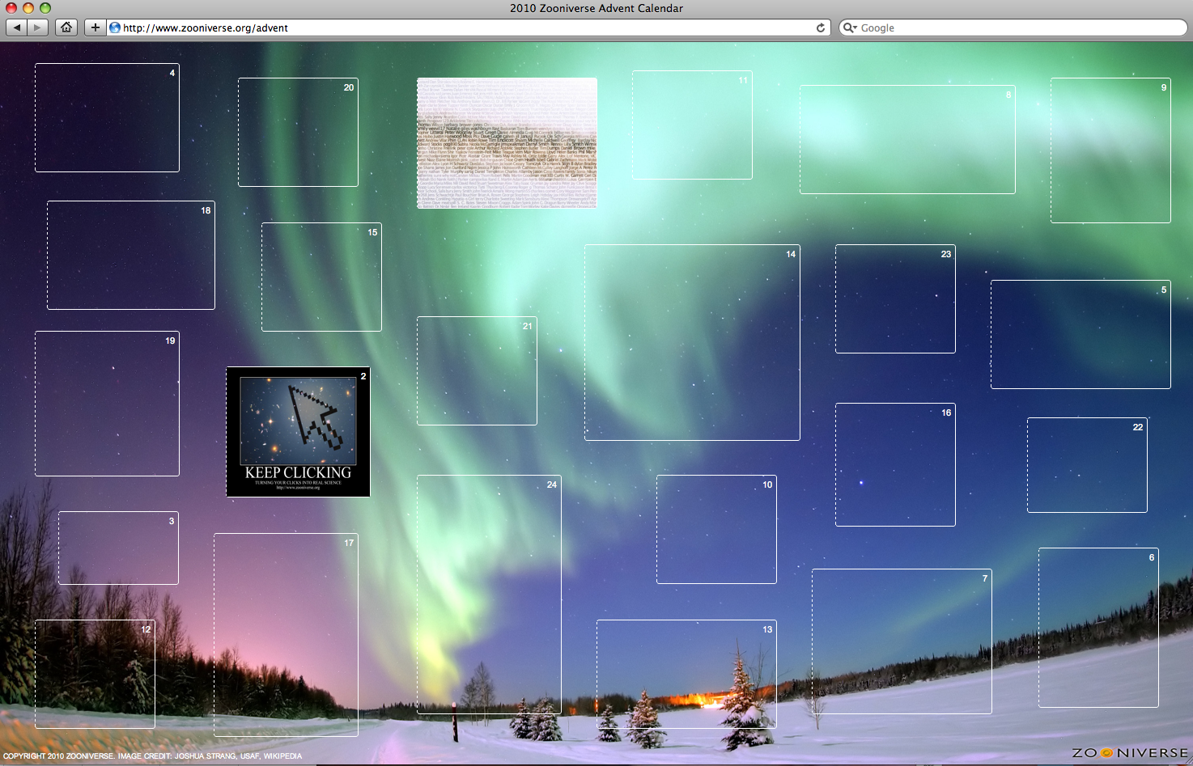
Merry Christmas
www.zooinverse.org/advent

Slide 39
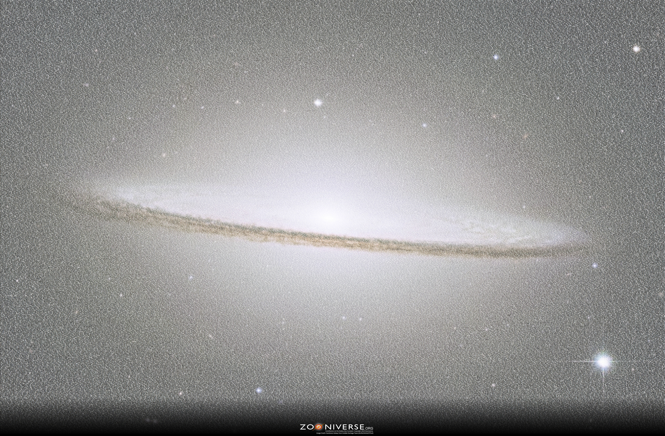
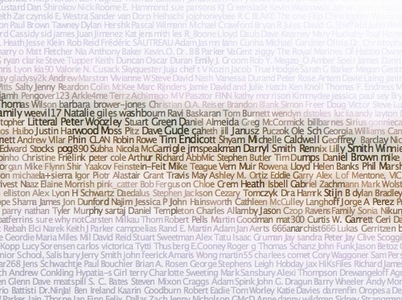
Notes:
35,000 names. Anyone who’s done at least 1 classification in Galaxy Zoo and given permission to be included.

Slide 40
^{星系总动员}
Science and Outreach Hand-in-Hand

Slide 41
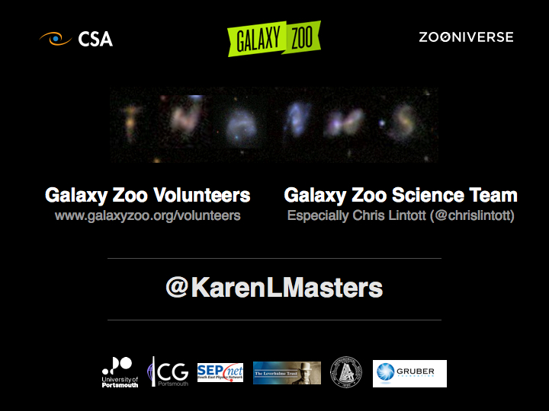
Notes:
Come and play in our ‘Xing (1) Xi (4) Zong (3) Dong (4) Yuan (2)’

